Slide 1
Time to MA vs A10 Analysis – Heparin Pivotal Study
February – March 2024
2024

Slide 2
Overview
Objective: Assess the distributions of the Time to MA (post R time) relative to 10 min (time to A10 parameter)
Data
HN pivotal trial
HN cartridge
CFFH and CRTH assays only
Primary and Secondary Analysis
Primary Analysis: Entire Population
Subgroups:
Study Indication Subgroups: Liver transplantation surgery, On-pump surgery, Not on-pump surgery
Study Timepoint Subgroups: 001,002,003
Coagulopathy Subgroups: Normal, Hypo, Hyper – according to the site physician assessments

Slide 3
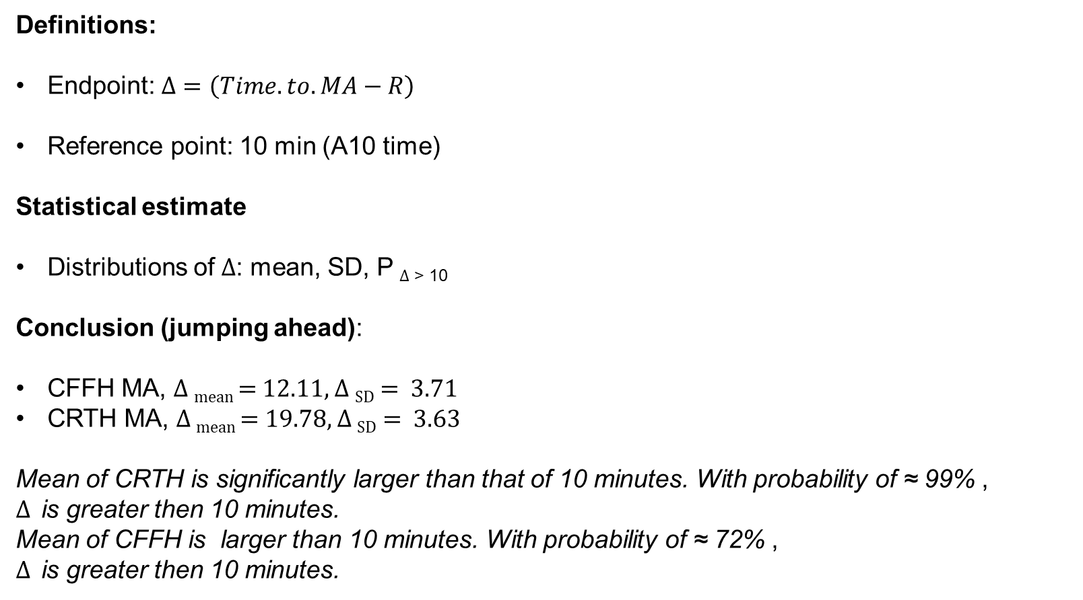
Analysis of Time to MA
Definitions:
Endpoint: $Δ=\left(Time.to.MA−R\right)$
Reference point: 10 min (A10 time)
Statistical estimate
Distributions of $Δ$: mean, SD, P $Δ$ _{> 10}
Conclusion (jumping ahead):
CFFH MA, $Δ$ _{mean} = 12.11, $Δ$ _{SD} = 3.71
CRTH MA, $Δ$ _{mean} = 19.78, $Δ$ _{SD} = 3.63
Mean of CRTH is significantly larger than that of 10 minutes. With probability of ≈ 99% ,
$Δ$ is greater then 10 minutes.
Mean of CFFH is larger than 10 minutes. With probability of ≈ 72% ,
$Δ$ is greater then 10 minutes.

Slide 4
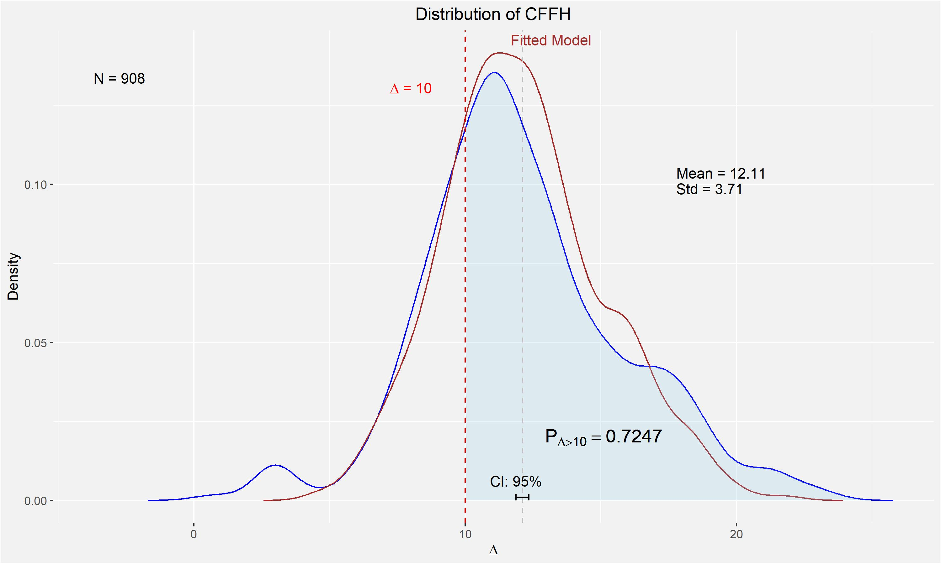
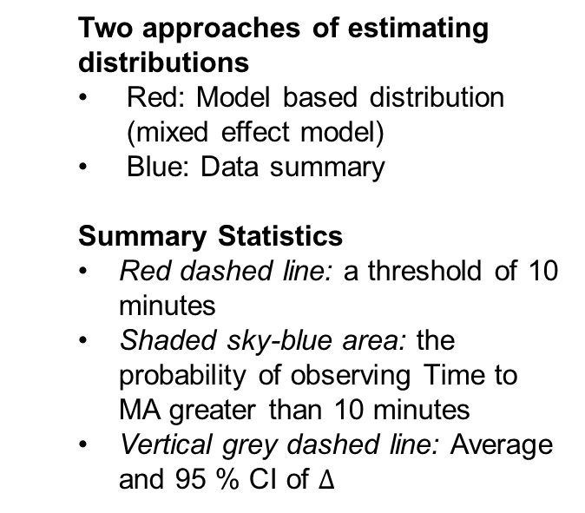
Two approaches of estimating distributions
Red: Model based distribution (mixed effect model)
Blue: Data summary
Summary Statistics
Red dashed line: a threshold of 10 minutes
Shaded sky-blue area: the probability of observing Time to MA greater than 10 minutes
Vertical grey dashed line: Average and 95 % CI of $Δ$
Plot 1

Slide 5
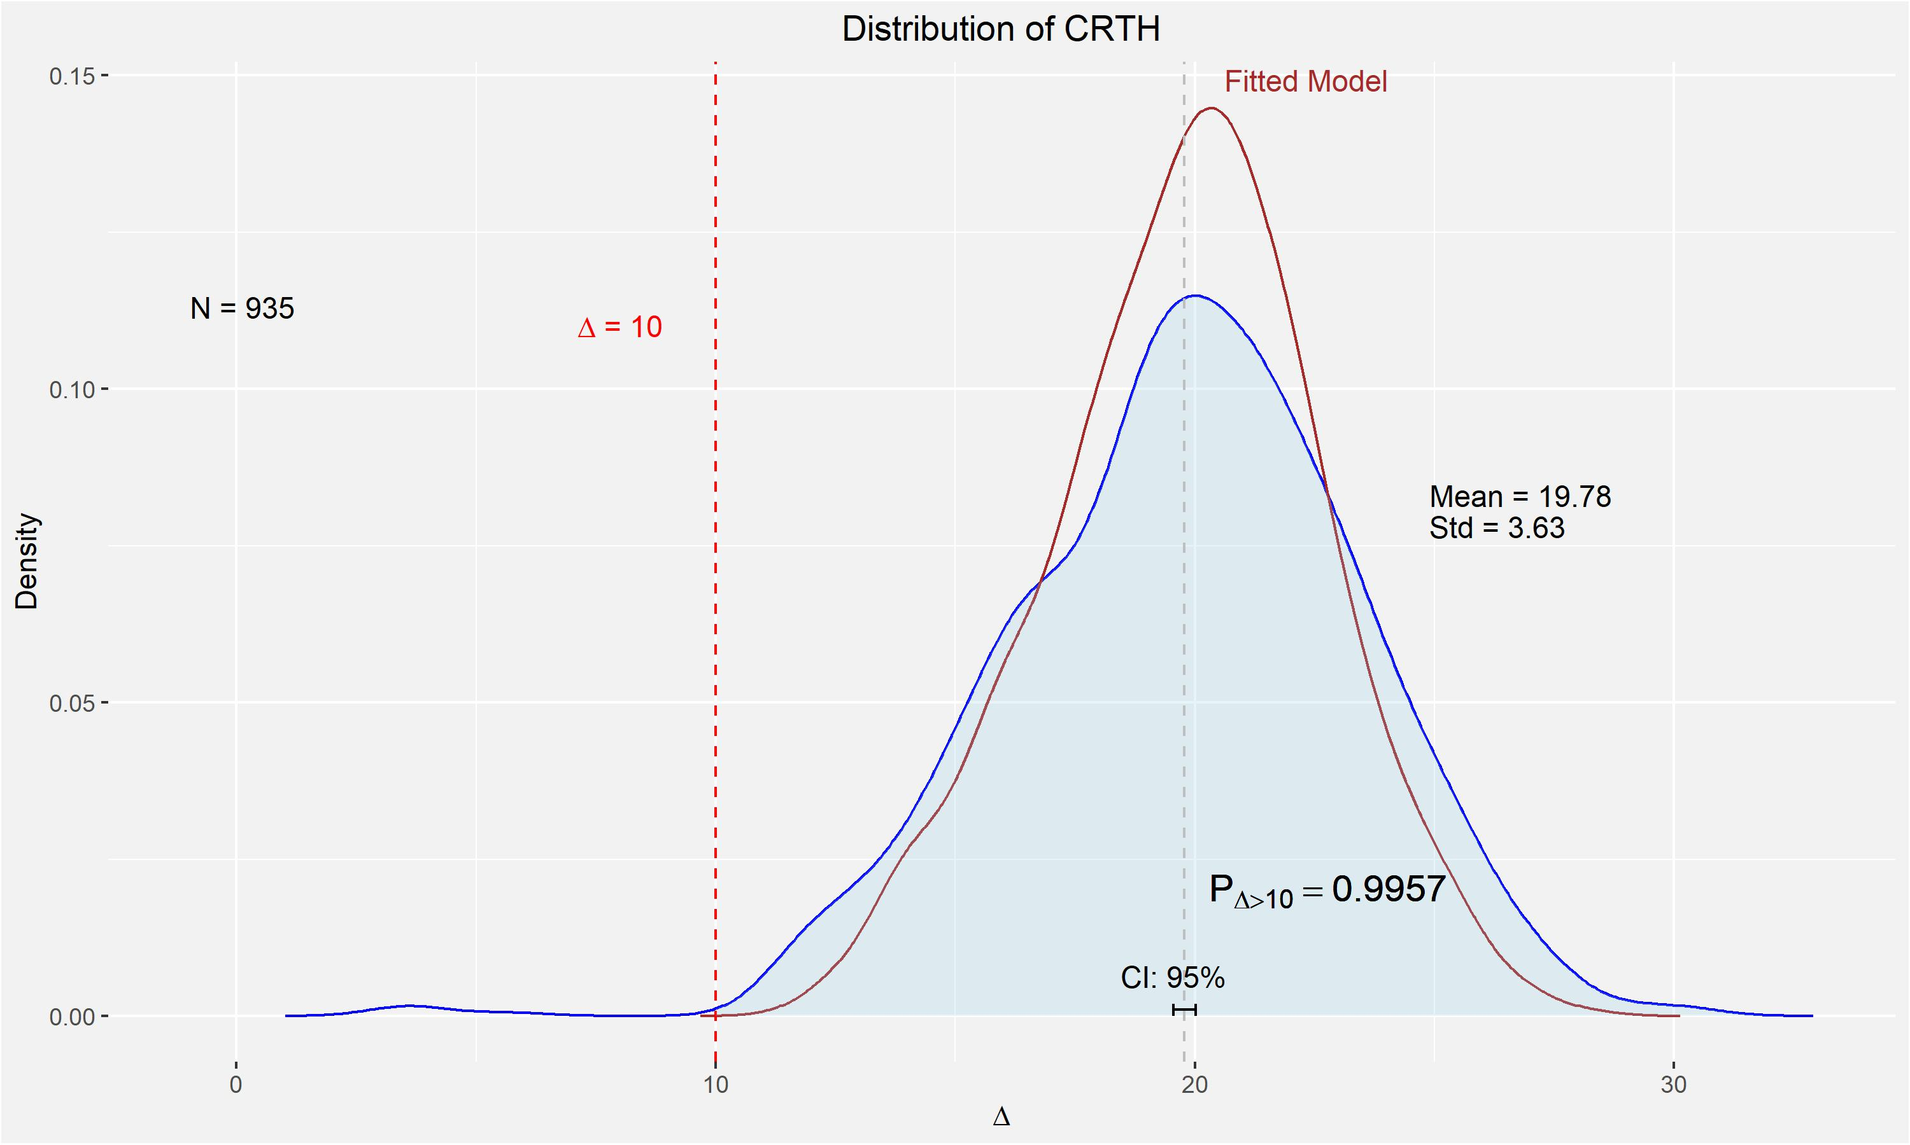
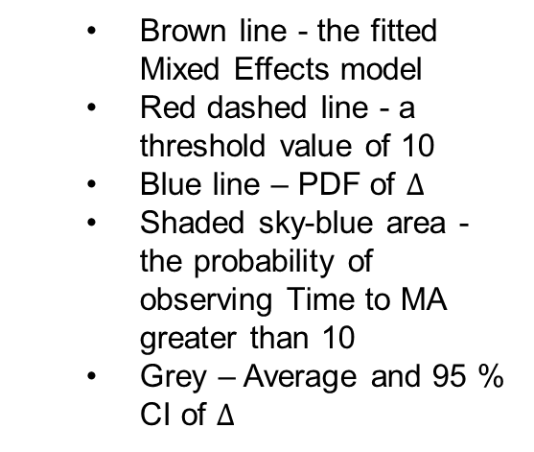
Brown line - the fitted Mixed Effects model
Red dashed line - a threshold value of 10
Blue line – PDF of $Δ$
Shaded sky-blue area - the probability of observing Time to MA greater than 10
Grey – Average and 95 % CI of $Δ$
Plot 2

Slide 6
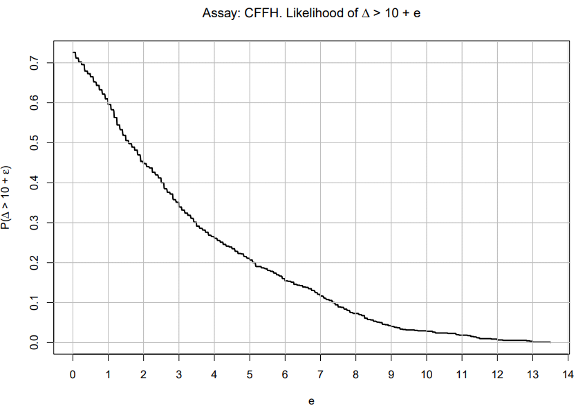
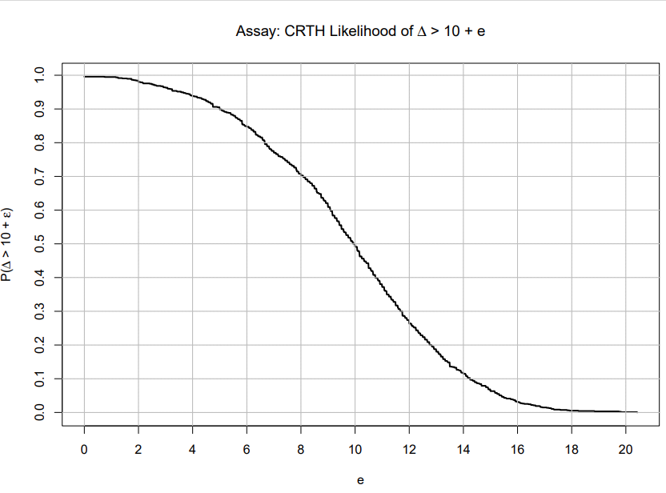
Likelihood of Time to MA exceeding 10 minutes plus epsilon.
Plot 3
Plot 4
The probability of Time to MA exceeding 10 minutes in CFFH earlier decrease compared to CRTH.

Slide 7
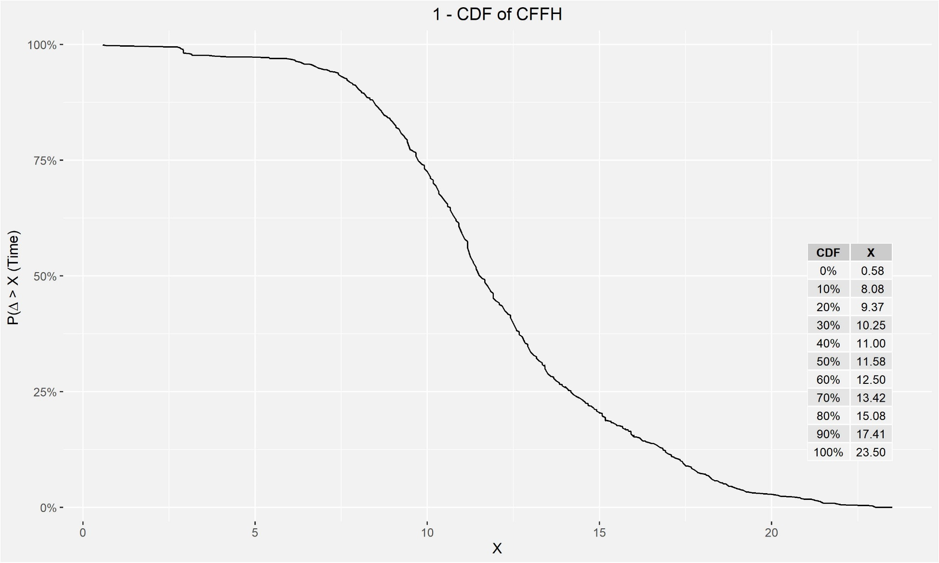
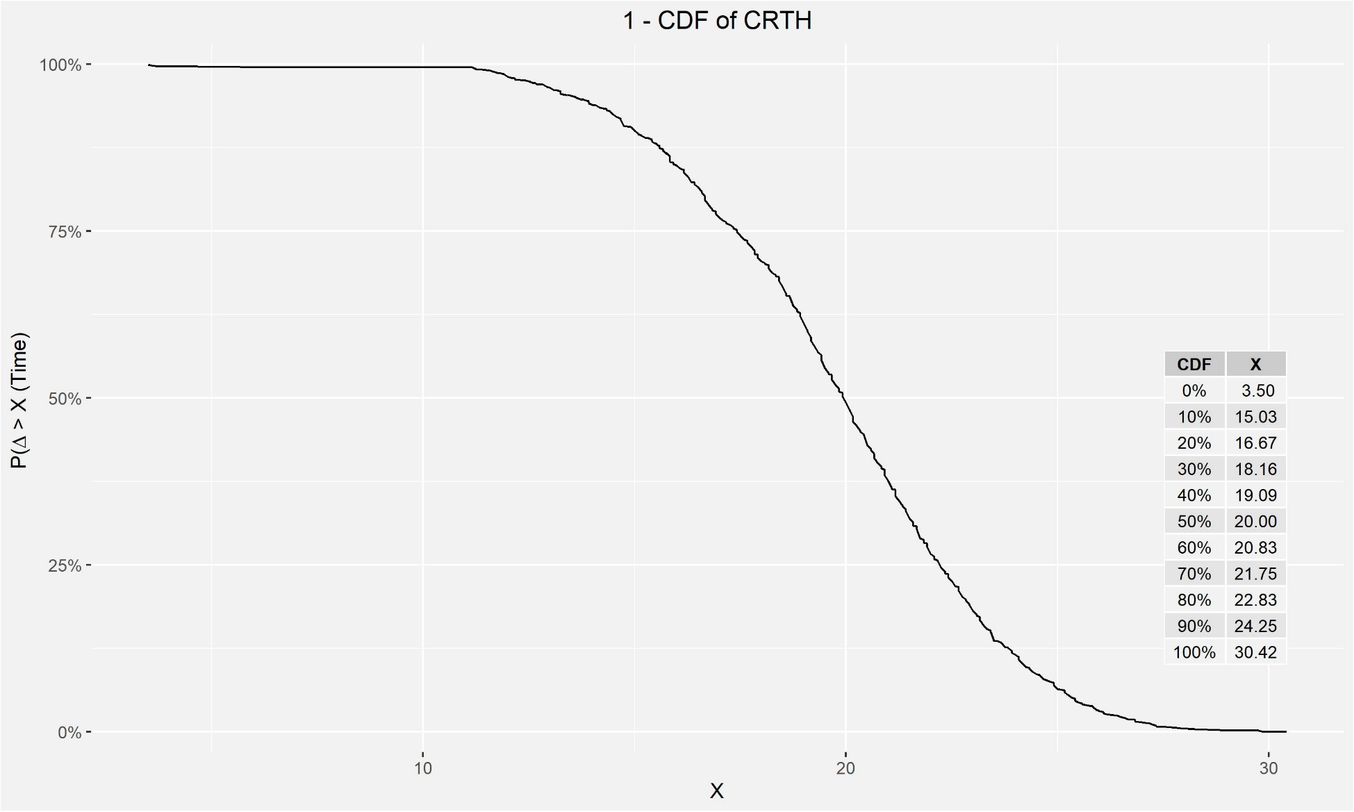
Similar this trend is illustrating the inverse of Cumulative Distribution functions of Time to MA accompanied by a table of percentiles.
For CRTH the probability of the 0.5 percentile is twice as large as in the CFFH assay.
Plot 5
Plot 6

Slide 8
Distributions by Subgroups
The subsequent three slides display the comparison of distributions between CFFH and CRTH assays across the following groups:
Coagulation status: Normal, Hypo, Hyper
Timepoint: 001,002,003
Indication: Liver transplantation surgery, On-pump surgery, Not on-pump surgery
Each plot includes
raw data jittered,
box plots of data within each subgroup (Q1 and Q3)
median and mean represented by brown and grey colours, respectively.

Slide 9
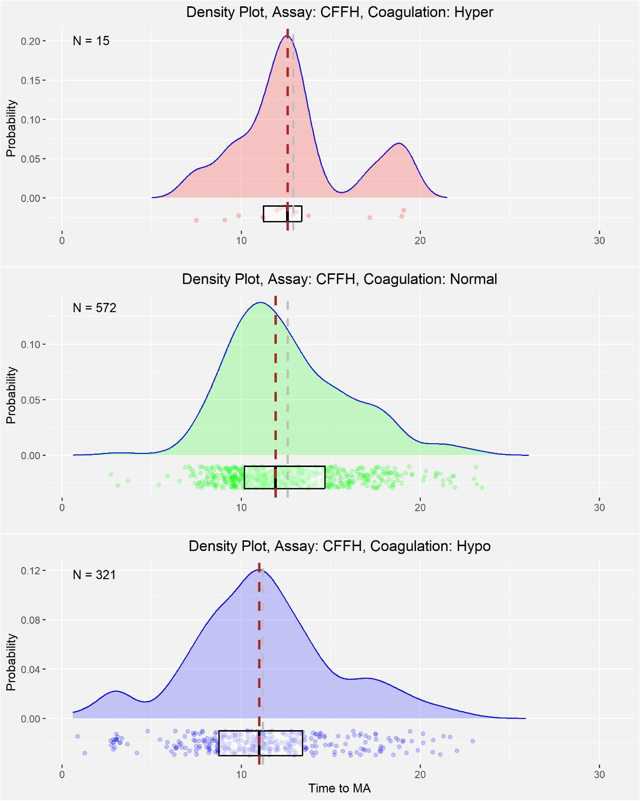
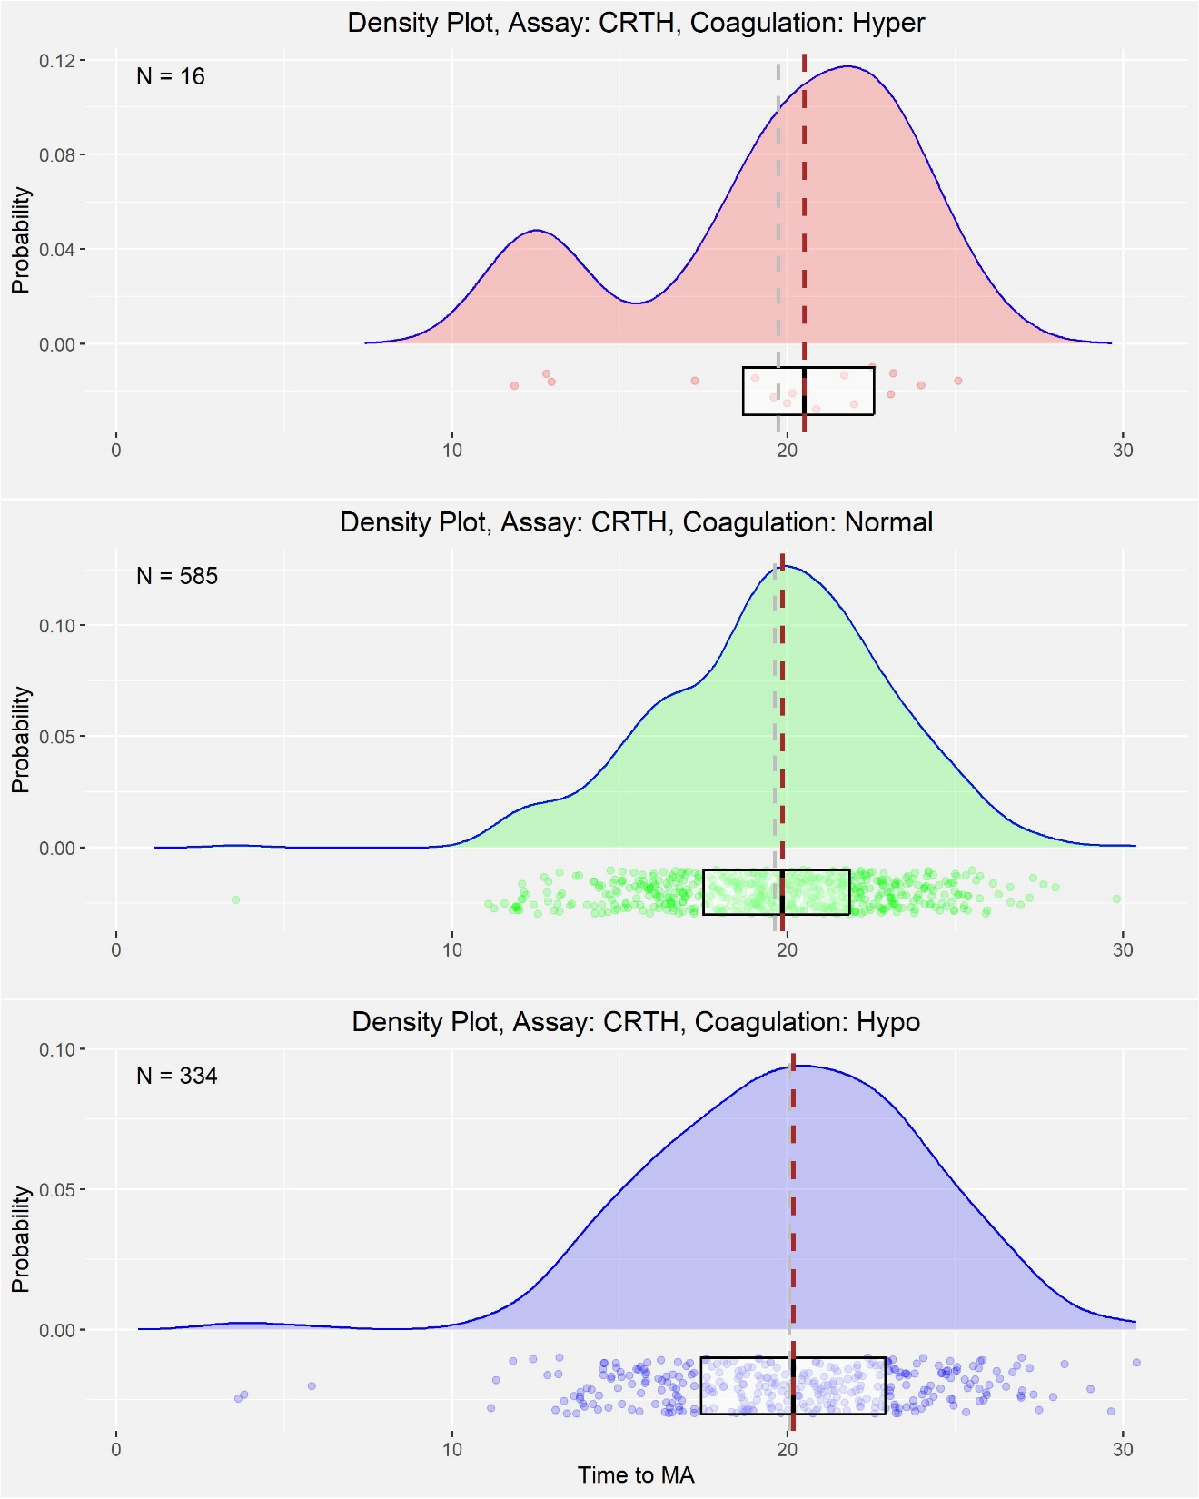

Slide 10
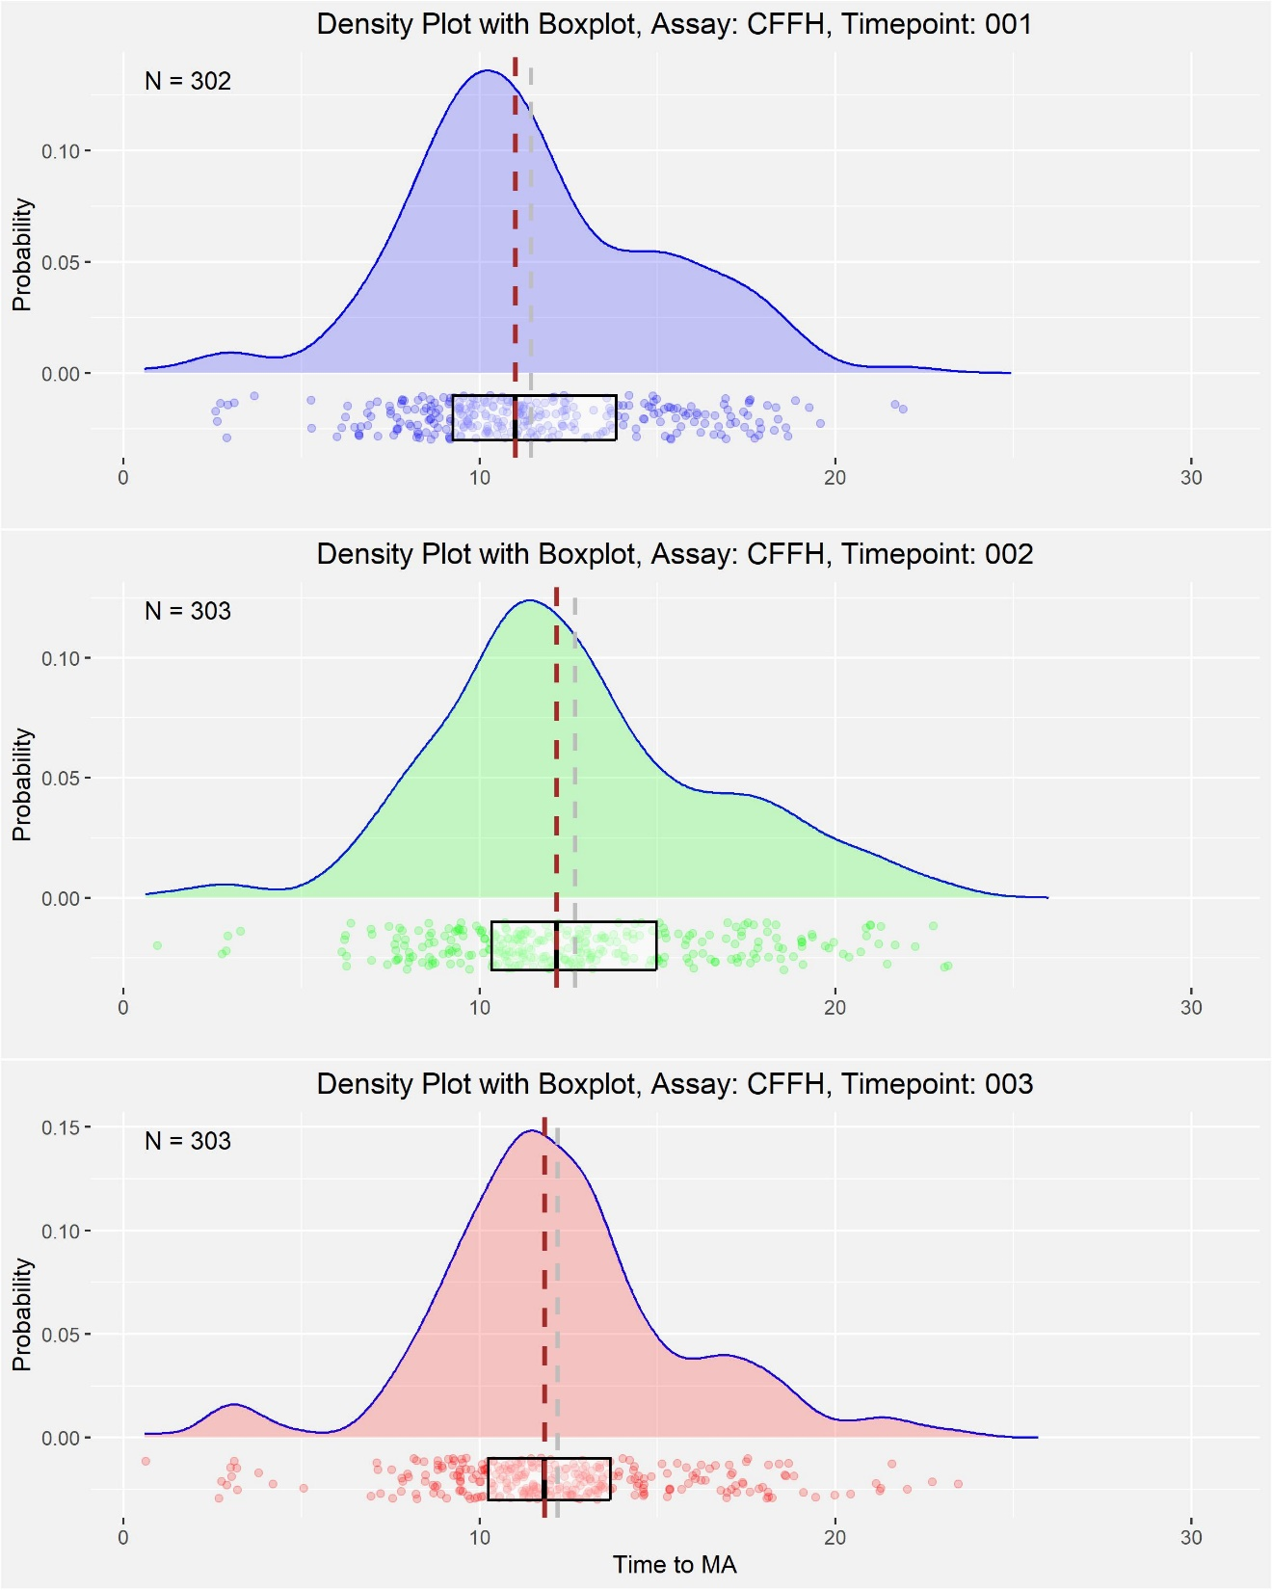
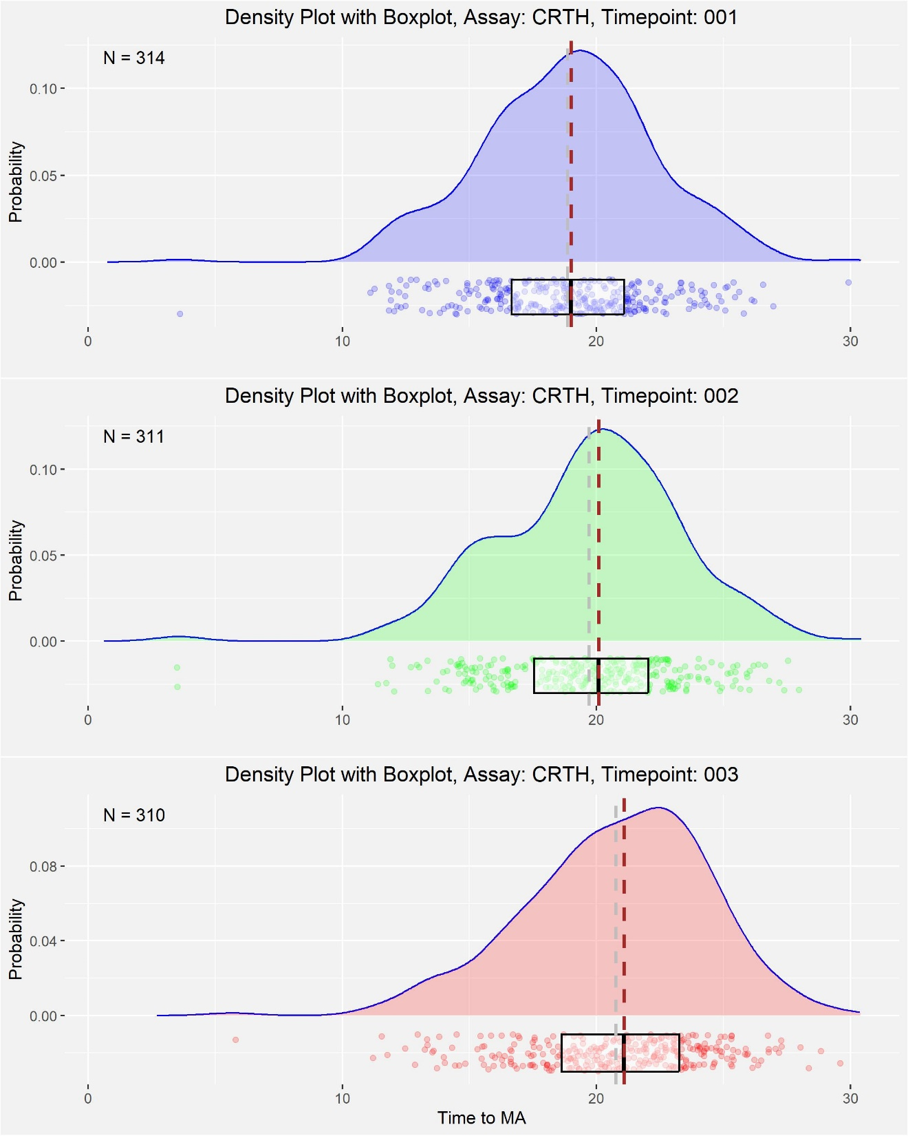

Slide 11
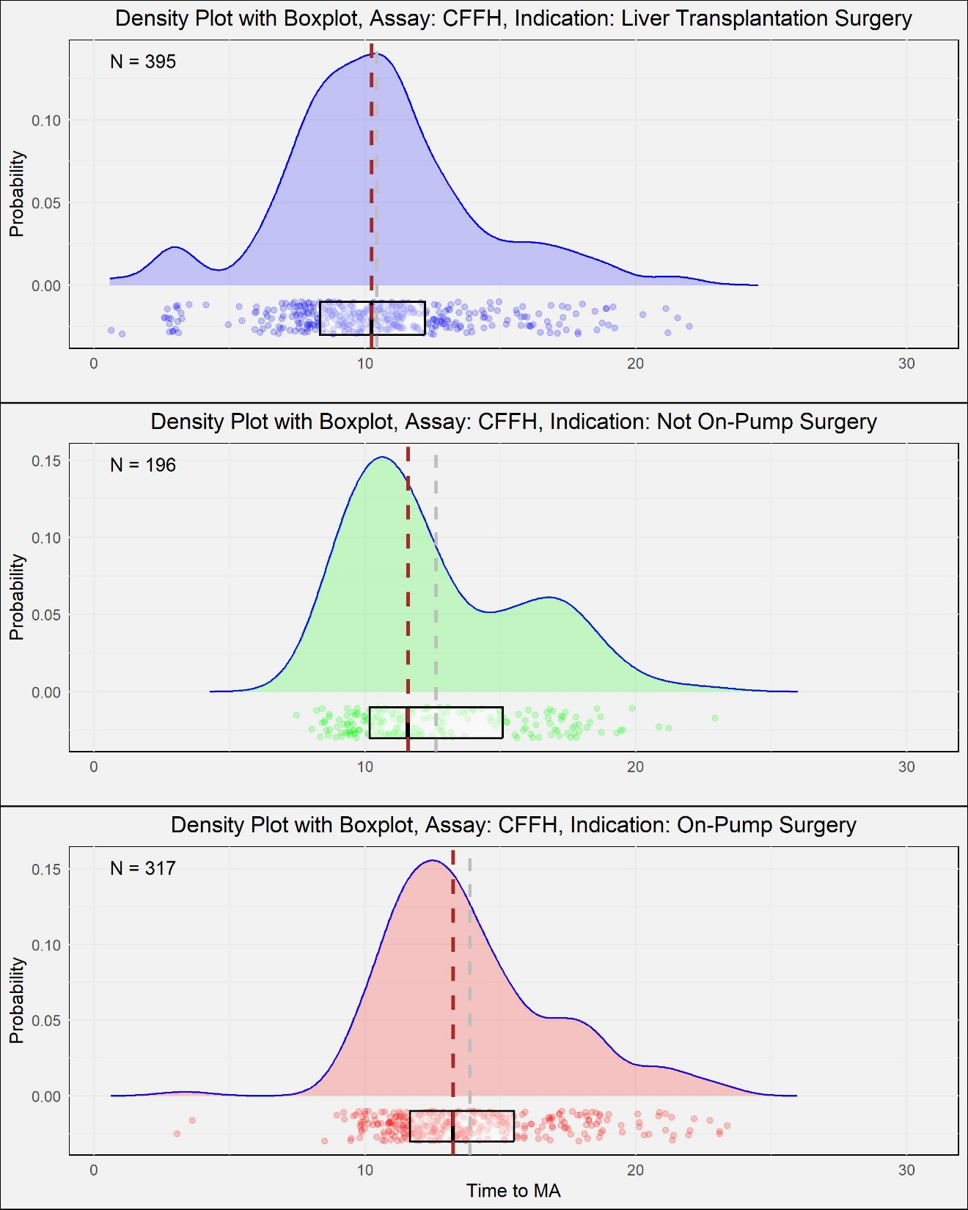
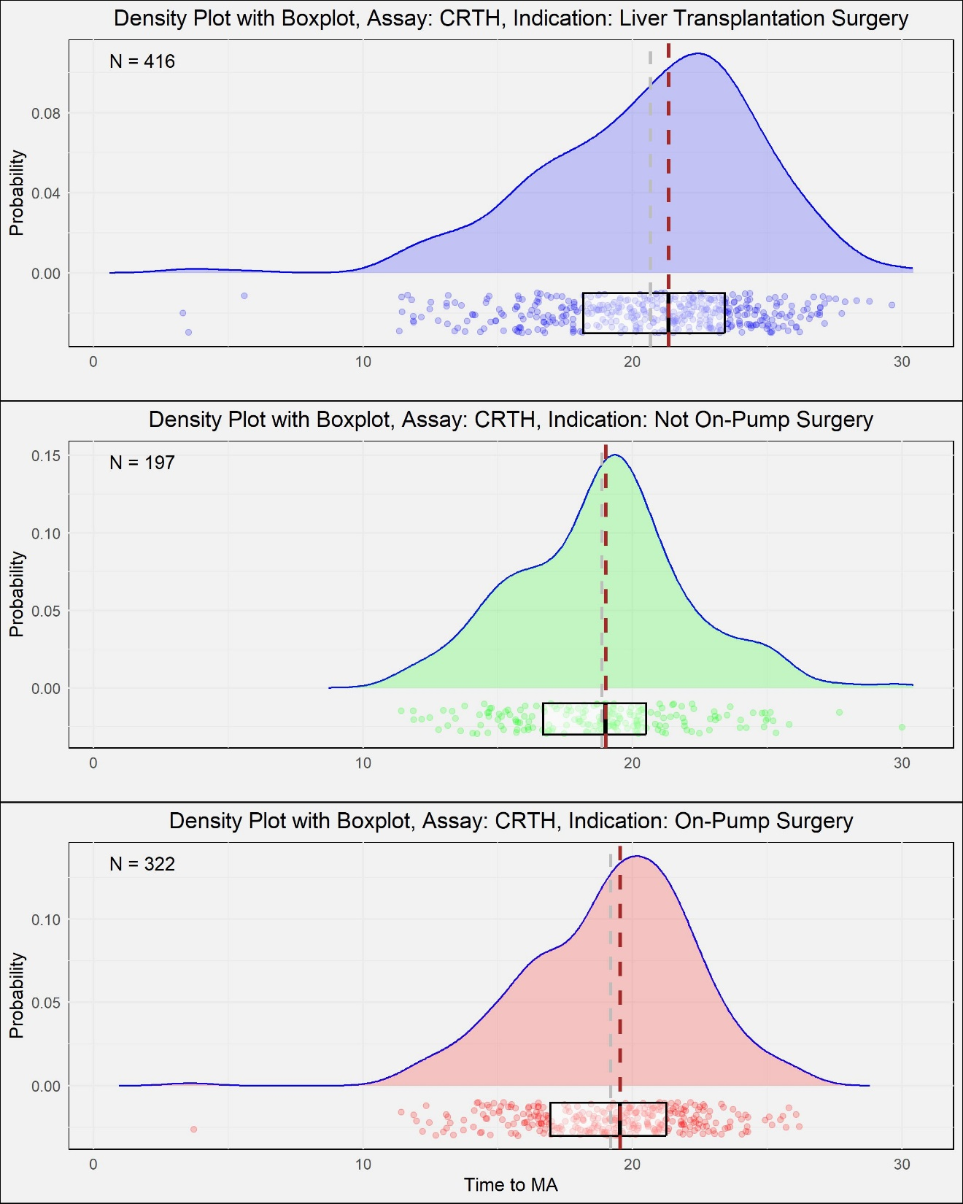

Slide 12
Multivariable analysis using Mixed Effect Models
Fixed effects | Estimate | Std. error | t value | P-value
Intercept | 9.770 | 0.842 | 11.607 | <0.001
INDICATION Not On-Pump Surgery | 2.284 | 0.436 | 5.234 | <0.001
INDICATION On-Pump Surgery | 3.438 | 0.378 | 9.094 | <0.001
TIMEPOINT 002 | 1.339 | 0.179 | 7.483 | <0.001
TIMEPOINT 003 | 0.948 | 0.169 | 5.615 | <0.001
COAG STAT Hypo | -0.240 | 0.834 | -0.288 | 0.774
COAG STAT Normal | -0.099 | 0.828 | -0.120 | 0.905
Model using CFFH data
Fixed effects | Estimate | Std. error | t value | P-value
Intercept | 19.762 | 0.795 | 24.869 | <0.001
INDICATION Not On-Pump Surgery | -1.940 | 0.453 | -4.284 | <0.001
INDICATION On-Pump Surgery | -1.557 | 0.392 | -3.975 | <0.001
TIMEPOINT 002 | 0.934 | 0.172 | 5.430 | <0.001
TIMEPOINT 003 | 1.926 | 0.162 | 11.868 | <0.001
COAG STAT Hypo | -0.197 | 0.779 | -0.252 | 0.801
COAG STAT Normal | 0.153 | 0.777 | 0.196 | 0.844
Model using CRTH data

Slide 13
Additional Conclusions
For CRTH assay average Time to MA (≈20) is significantly higher than CFFH Time to MA (≈12).
Possible explanation: Higher MA time
In both the CFFH and CRTH assays, Coagulation Status was determined to be statistically insignificant in predicting Time to MA.
Compared to the baseline at Timepoint 001, Timepoint 2 and 3 have statistically significantly higher Time to MA for both CFFH and CRTH.
Compared to baseline liver transplantation when comparing it to other indications, two distinct images emerge.
In the CFFH assay, indications On-pump surgery, Not on-pump surgery have higher Time to MA
Conversely, in the CRTH assay, indications On-pump surgery, Not on-pump surgery have lower Time to MA

